Slide 1


ArcGIS API for JavaScript: Using Arcade with your Apps
Kristian Ekenes and David Bayer
Notes:
[DAVE] Introduction

Slide 2
Session Goals
Overview of Arcade
What is Arcade
Why use Arcade
Arcade Language
Variables, Functions, Loops, Conditional Statements
Arcade and the ESRI JavaScript API
Using Arcade in Custom Apps
Notes:
In this session, we are going to give an Overview of Arcade… What it is, and why you would want to use it.
We are going to look at the language, and then lastly look at how you can use it in your own Apps, written in JavaScript.
Now Lets get into the really important questions. These are the questions we are most commonly asked about Arcade

Slide 3
A new expression language for the ArcGIS Platform
ArcGIS Pro
Runtime SDKs
JavaScript API
Web apps
Primarily designed for ArcGIS web maps and web scenes
What is Arcade?
Notes:
Explain …..
-> History of calling Languages After Street Furniture -> Avenue
-> UK Connection… One of the Development Teams was in Wales
-> Arcade a Smaller, Safer Shopping Street
-> Seemed to Work… We did consider other names… Boulevard, Roundabout

Slide 4


Why is it called Arcade?
Notes:
Explain …..
-> History of calling Languages After Types of Street-> Avenue
-> UK Connection… One of the Development Teams was in Wales
-> We did not want to call it Roundabout, thought it might set the wrong impression.
-> Arcade a Smaller, Safer Shopping Street
-> Seemed to Work… We did consider other names… Boulevard

Slide 5
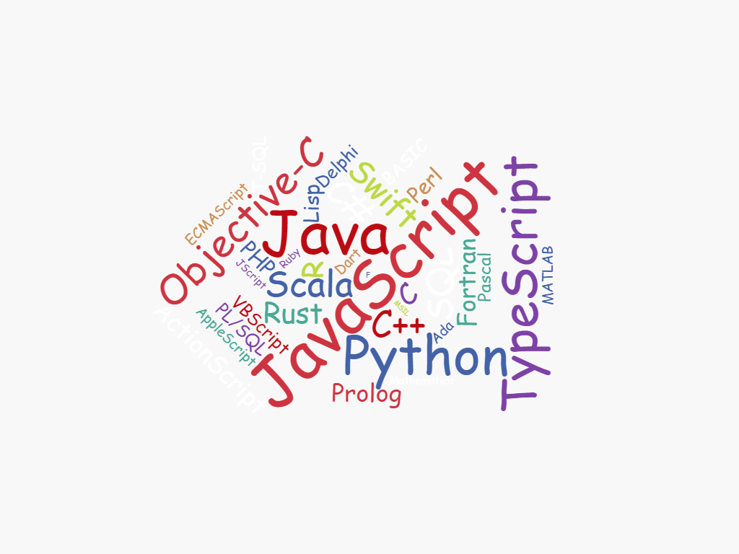
Why do I need another language?
Notes:
This is a question… We are asked a lot……..
Why another language, there are so many to choose from..
We put a lot of thought into why we were writing Arcade, and the problem it is solving… As we go through the talk… you will hopefully see why we have gone down this route, and see the gap it is trying to plug.

Slide 6
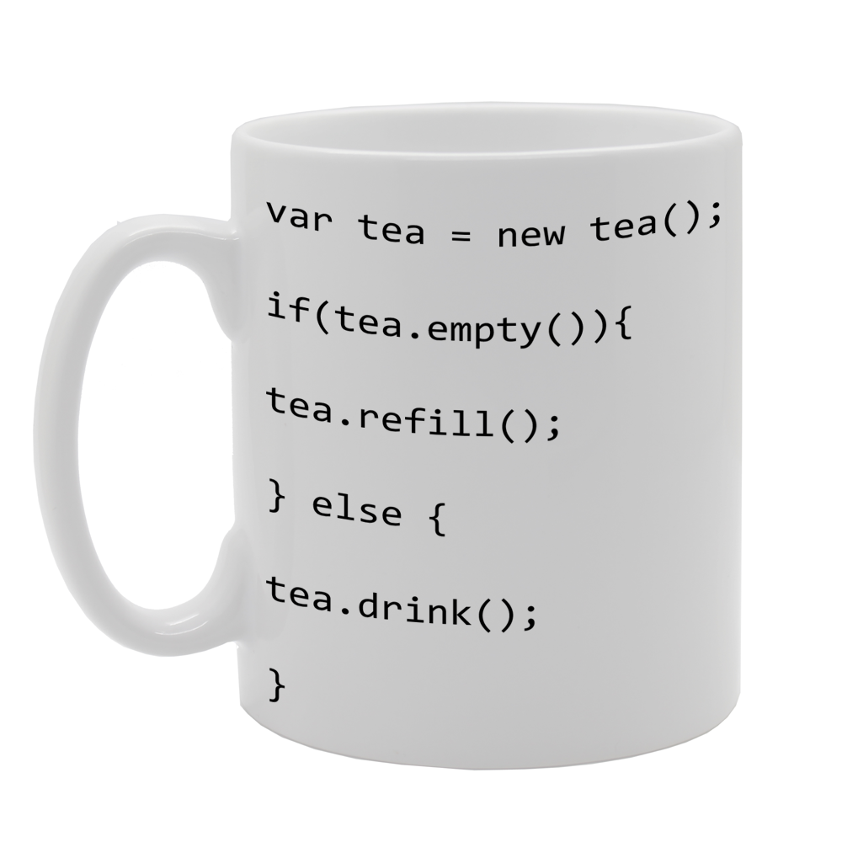
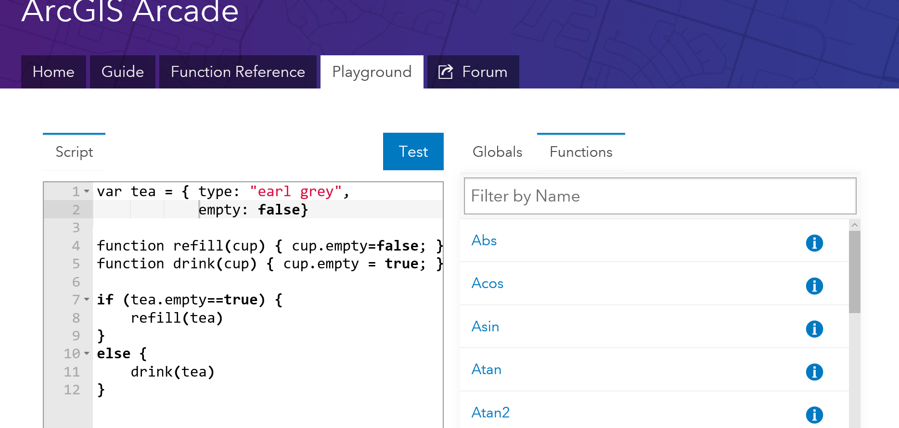
What can I do with it?
Notes:
The final question is….
As an example, I thought I would take the classic tea problem, and write it in Arcade.
Again, as we go through the talk, will give an answer to this.

Slide 7
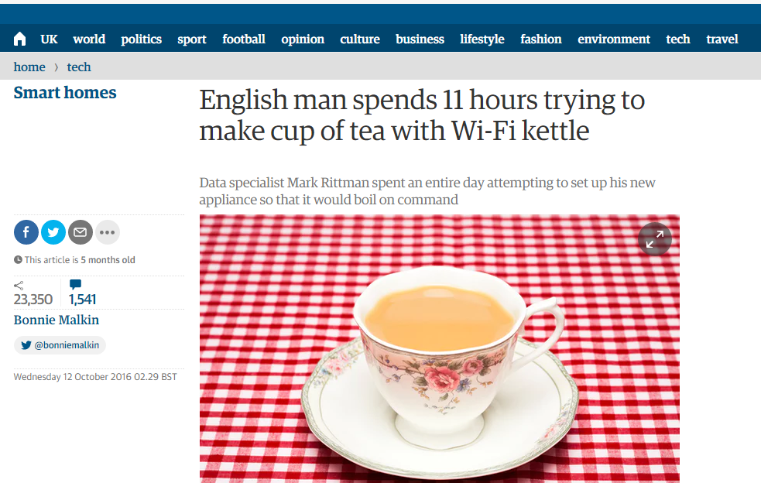
Notes:
Arcade, will not make tea, but there are several specialists working on that with other languages.

Slide 8


ArcGIS Apps and Maps
Collector
Web AppBuilder
ArcGIS Pro
Open Data
Configurable Web Apps
web maps
Operations Dashboard
ArcMap
Viewer
Workforce
Mobile
Explorer
Workforce
Dispatcher
Insights
Story Maps
ArcGIS for Office
Notes:
To explain, why we have a language called Arcade, we need to go back a bit and look at the ArcGIS Platform.
The ArcGIS Platform is very extensive… There are many different apps, and tools and capabilities

Slide 9


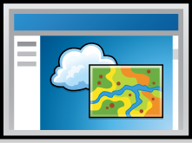
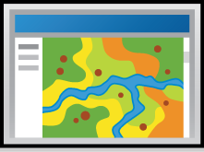
ArcGIS Environments and Platforms
Smart Phones
Social Media
Tablets
Web Sites
Desktop
Browsers
Notes:
Another view of all of these different Apps, is to look at all the different Environments that the ArcGIS Platform runs on
It runs on Desktop, Tablets, Phones, Embedded in Social Media, as WebSites

Slide 10




ArcGIS Extensibility and Customization
Map and Analysis Logic
Add-Ins / Extensions
Custom Application
Web
ArcGIS JavaScript API
Mobile
ArcGIS Runtime SDK for Android
ArcGIS Runtime SDK for .NET
ArcGIS Runtime SDK for Qt
ArcGIS Runtime SDK for iOS
Desktop
ArcGIS Runtime SDK for Java
ArcGIS Runtime SDK for .NET
ArcGIS Runtime SDK for Qt
ArcGIS Runtime SDK for macOS
ArcGIS Pro
SDK for
Microsoft .NET
Notes:
The ArcGIS Platform, is very extensible…
This whole conference is about building with the technologies available in the ArcGIS Platform…
We can divide the extensibility of the ArcGIS Platform into many different areas…
Custom Applications are very well covered. Add-Ins and Extensions are very specific to the Apps themselves. So Desktop Supports writing Adding.
Where we have a gap, is when you are writing custom map logic or analysis logic. This is where we are really in the ‘domain’ of GIS.

Slide 11
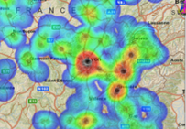
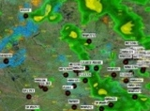
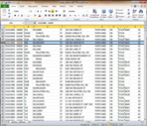
ArcGIS: Make, Share, Anywhere
Notes:
The reason this is a gap, is because we want publish and share maps and analysis.
If we have customised those maps with logic written in Python, or JavaScript, it becomes difficult to share the map, and use it in all the places you want to have access to the map

Slide 12

ArcGIS: Make, Share, Anywhere - Challenges
Traditional Development / Scripting Languages
Browser based Apps
Mobile and Native Apps
Size of Executable
Security
Native Access
Page Size
Security
XSS
No Binaries
Notes:
There is often the question, why you cannot just shared the customised logic..
Say you have written a labelling expression in Python in ArcGIS Pro… why can you just not include python on mobile devices, or the JavaScript engine..
The problem is twofold, adding as an extensive engine as Python or JavaScript is very sizeable, for resource constrained devices.
And Secondly, more important… Security.. Scripts written in JavaScript or Python can do anything… Which means you need to somehow run them in a sandbox, or similar.
For Browser based applications… They only run JavaScript, so your python script will not work… Or you will have network latency to run the python on the server…
Also security, running JavaScript is not going to be very accecptable to Sys Admins.

Slide 13
Arcade Purpose
Arcade is NOT intended to be a Full Programming / Scripting Language
Goal : Lightweight and Simple
Equivalent to a Spreadsheet Cell Calculation
Embedded Expressions
Labeling, Rendering, Symbol Variation, ….
Sharing
Not a replacement for Python for geoprocessing and Automation
Input Values
Arcade
Expression
Result Value
Notes:
This is why we have developed Arcade… Not as a Full Programming or Scripting Language, but as a Simple Expression Language.
Equivalent to an Excel Spreadsheet calculation.
It is simply intended to take input values, evaluate them, and return a result value.

Slide 14
Arcade Goals
Portable
Write an Expression in Pro, have it run in a Browser, or on a Device
Secure
Ensure that Expressions or Scripting do not compromise Security
Lightweight
Most requirements for Scripts and Expressions are Lightweight. The language should be small, and fast
Geospatial
Scripts should treat Geospatial as First Class Members
Notes:
The goals of Arcade are as follows.

Slide 15

Global Variables and Profiles
Labeling
Rendering
Use Expressions to provide values required for different types of Renderers
Global Variables
$feature
$view
Use Expressions to provide values required for different types of Renderers
Global Variables
$feature
$view
Future Profiles
“
Profiles provide the purpose for executing an Arcade Expression
Notes:
Whilst Arcade is a Language, it is not tied to any particular workflow. It is simply passed input variables (as globals), runs, and return output variables.
We have the concept of a Profile, which determines why the Script is being run, and what globals it will have available.

Slide 16
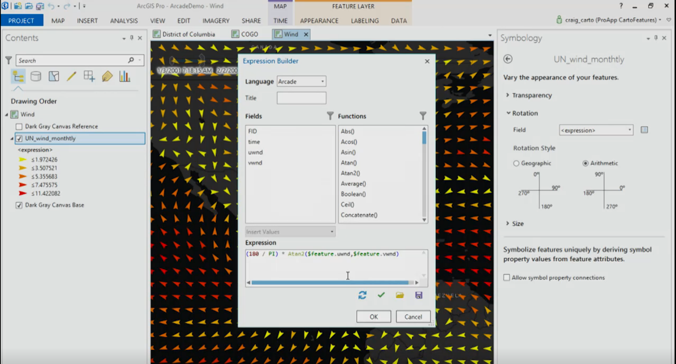
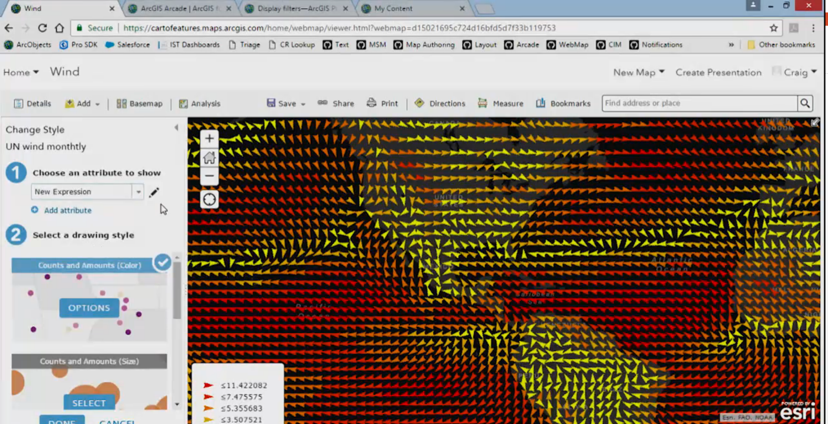
Hello World
And a few more examples…
Notes:
Playground – Hello World
ArcGIsOnline Map -> Showcase Maps with Renderers, and Labelling → Really Simple Ones
ArcGIs Pro Demo -> Showing a Map, Published to ArcGis Online → Really Simple Ones

Slide 17
Language Overview
Type System
Flow Control
Statements
Functions
Statements
and Operators
Notes:
OK… Hopefully you can see why we have written Arcade.
We are now going to go into the Language a Bit. So you can see how we have tried to reach the goals of simplicity and ease of use, but also so you can see how to achieve common tasks.

Slide 18
Arcade : Language Features
Designed for Simple Expressions
Single Line - Implicit Returns
Case Insensitive Language
Dictionary Syntax for Field Access
Has Language Features to Support more Complex Scripts
Type System
Implicit and Explicit Type Casting
Flow Control Statements: IF, FOR
Variable Declaration and Assignments
User Defined Functions
Arcade Scripts run and return a value. They are self contained and cannot alter their environment.
Notes:
Firstly , we tried to design the language for Simple Expressions, and Familiarity..
We wanted it to work for the simplest of single line expressions…. Say just to put a calculation in based on a Field.
We also recognised that many of the labelling, renderering scripts that exists in Pro today, written in Python can be quite complex…
So we wanted to support more complex language features.
Do need to emphasize though, that Arcade is not intended to change its environment, it is simply a calculator, and is self contained.

Slide 19
Implicit Returns
(10 + 100) * 30
Equivalent to:
return (10 + 100) * 30;
Implicit Returns
Last executable statement that is a value, will automatically be considered the return value.
Enables very simple Single Line Expressions
Notes:
So firstly for simple expressions, we have the concept of Implcit Returns.
The last executable statement that is a value, will automatically be considered the return value… Allows you, for single line expressions, not to have to use the return statement.
A small feature, but allows very succinct single line expresions.

Slide 20
Case Insensitive
UpPeR(“Hello”)
$FeAtUrE.FiElD1
Language is Case Insensitive
Quicker to Author
Simpler for working with Data, and Field Names
Notes:
Case Insentitivity… We had a lot of discussions on this.
We have made the language case insensitive so it is less fussy to author. However the main reason, was to make it easier to work with fields.

Slide 21
Functions
Data Functions
Dictionary
DomainCode
DomainName
Feature
First
HasKey
IndexOf
Reverse
Sort
TypeOf
Date Functions
Date
DateAdd
DateDiff
Millisecond
Minute
Hour
Month
Weekday
Year
Day
Now
Today
Geometry Functions
Geometry
Multipoint
Extent
Polyline
Polygon
Logical Functions
IsEmpty
DefaultValue
When
Decode
Iif
Boolean
Mathematical Functions
Abs
Acos
Asin
Atan
Atan2
Average
Ceil
Cos
Count
Exp
Floor
Log
Min
Max
Number
Pow
Random
Round
Text Functions
Concatenate
Console
Find
Lower
Left
Mid
Proper
Replace
Right
Split
Text
Trim
Upper
Sin
Sqrt
Stdev
Sum
Tan
Variance
“
Functions are the Power of Arcade
Notes:
The key to the language though is the range of functions, and we want to add a lot more!

Slide 22
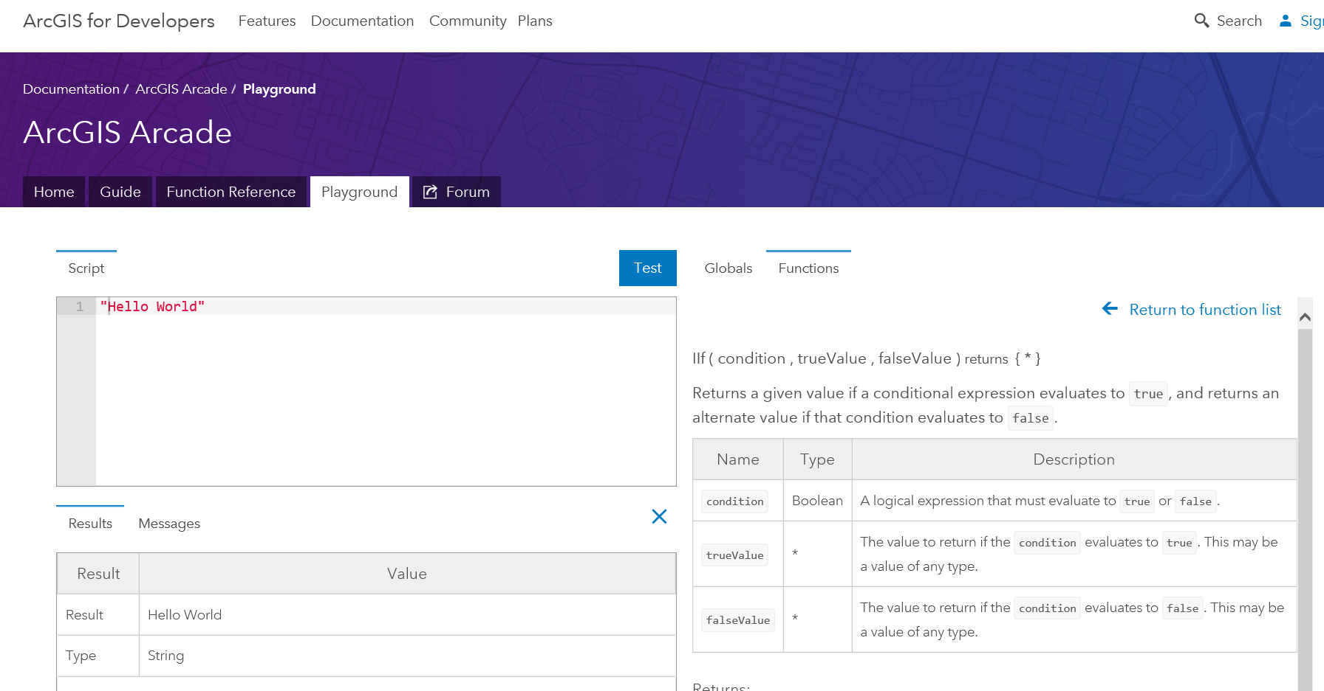
Exploring Profiles and Functions in the Playground
Notes:
Demo of the Playground and Profiles
Look at the Language Help

Slide 23
Type System
Simple Types
Numbers
Booleans
Dates
Strings
Object Types
Dictionary
Feature
Array
Point
Line
Polygon
Multipoint
var myNumber = 10;
var myText = “Hello”;
var myDate = Date(2015,1,1);
var myBool = true;
var myDictionary = { “key1”: 10 };
var myFeature = { “geometry”: {…}, “attributes” {“key1”: 10 }};
var myArray = [1,2,3];
var myPoint = Point({….});
Dates, Dictionary, Feature, Point, Line… all have overloaded constructors.
Notes:
Continuing with the Language.. Arcade does have a Type System
We have added GIS Specific types, like Feature, Point, Line, Polygon, MultiPoint.

Slide 24
Implicit and Explicit Type Casting
Implicit Casting
return 10 + “Hello”
Explicit Casting:
return text(10) + “Hello”
Implicit Casting
For Function Parameters
For Expressions
Explicit Casting
Functions cast between types
Number, Text, Date, Boolean
Notes:
As there is a typesystem, there is Casting between types.
We had a lot of discussions on casting, and what was correct behaviour

Slide 25
If Statement
IF Statements are supported in the Language
For simple single line expressions, consider using Functions
IIF
Decode
When
if (myvalue==true) {
return 1;
}
else {
return 2;
}
Equivalent to:
IIF(myvalue==true, 1, 2)
Notes:
As you would expect we have flow control statement and logic statement.
So we have IF… But you may also want to consider using IIF, Decode, and When, which allow you to use functional equivalence.

Slide 26
For Statement
For Statements
Same syntax as JavaScript
For In Statements
Iterates over indices of an array, or field names of a Dictionary or Feature
Break, Continue and Return Statements Supported inside Block
for (var z=1; z<100; z++ ) {
k+=z;
}
for(var k in myArray) {
n+=myArray[k];
}
Notes:
For Statements….
You have break, return and continue all supported

Slide 27
User Defined Functions
function MultiplyNumber(thenumber) {
return thenumber*10;
}
MultiplyNumber(10);
Function Keyword used to Declare Functions
Must be Declared ahead of Use
Variables defined inside of Function, have Local Scope
Functions cannot be declared inside of Functions.

Slide 28
Variable Assignment
++myNumber
i=i+1;
myArray[10]=11;
myFeature.Field1 = “ddd”;
Variables can have their values reassigned.
Objects Types maybe Immutable, if passed into Arcade.
Arrays are not Sparse. They must be sequential.
Geometry Types are immutable inside. You cannot change the points in a path of a line.
Notes:
We also have variables, that can assigned and reassined.

Slide 29
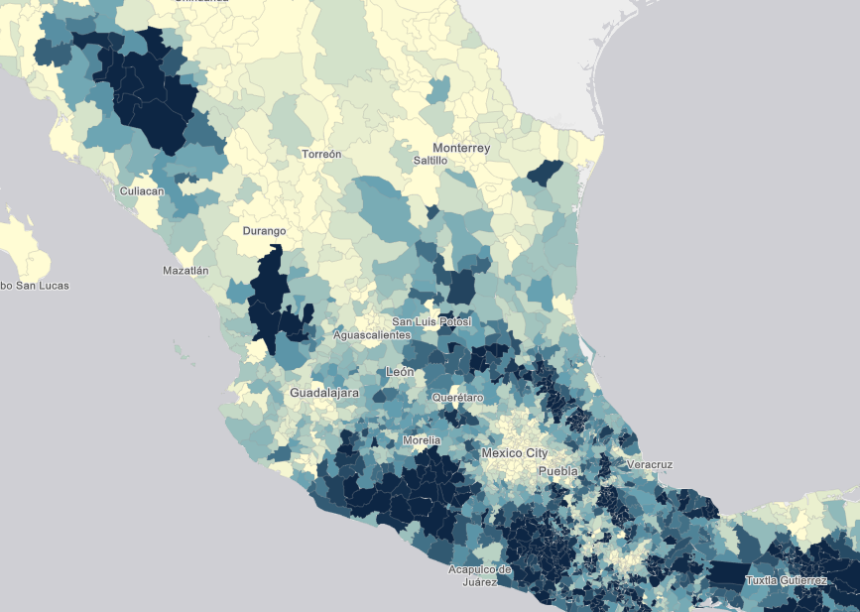
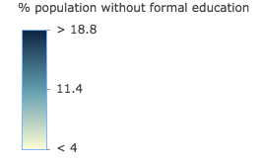
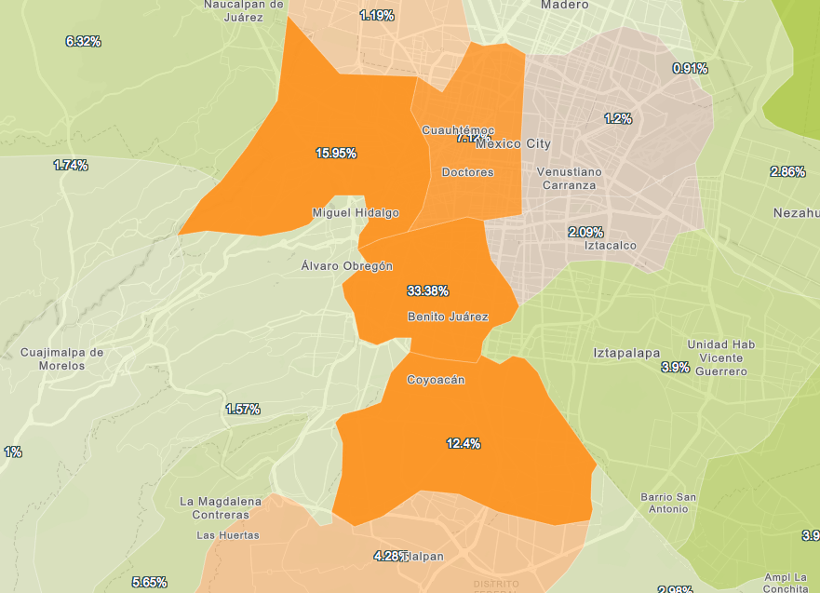
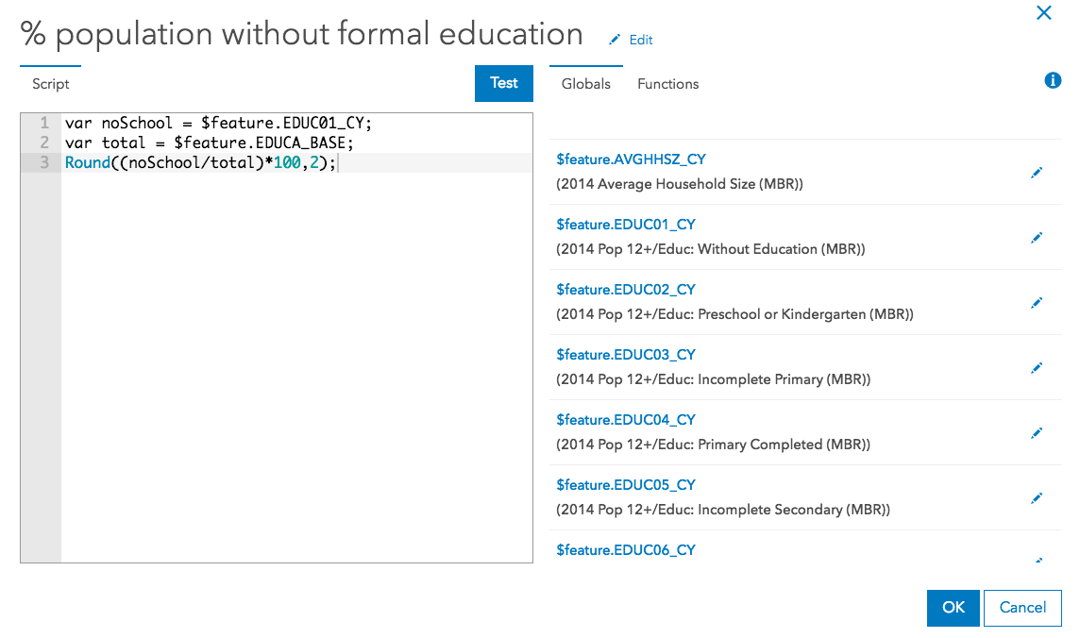
Demos
Notes:
[KRISTIAN]
Now you have seen the language….
Implicit Return one
Lets look at more Complex Examples

Slide 30

Arcade and the ESRI JS API
ESRI JS API
Version 3.19
ESRI JS API
Version 4.2
Arcade
Arcade
Inside
Inside
“
Arcade Interpreter available in both 3.19 and 4.2 JavaScript API
Notes:
So the last part of the talk, is to look at using the Arcade Compiler inside your own Apps written in JavaScript.
It is important to state the Arcade, works in Pro. It is available as a C++ engine, and a JavaScript engine

Slide 31
ESRI JS API : Arcade Expressions
Arcade Expressions set as Properties
Classes which have Arcade Expressions
ClassBreaksRenderer
UniqueValueRenderer
Visual Variables of Renderers
Color
Size
Opacity
Rotation
Supported for FeatureLayer and SceneLayer
Notes:
In the JS API, Arcade is exposed as properties of existing Classes.
So you can set valueExpression for ClassBreaksRenderer and UniqueValueRenderer
You can set Color, Size, Opacity, Rotation Visual Varuables

Slide 32
ESRI JS API : Arcade Expressions
var renderer = new ClassBreaksRenderer({
valueExpression: "( $feature.TOT_VOTES / $feature.REG_VOTERS ) * 100",
valueExpressionTitle: "Title to Display"
classBreakInfos: [ ... ],
});
Expression Properties are set as Literal Strings
Arcade Interpreter will Execute valueExpression for every Feature
Notes:
Setting expresionss is simply about setting the property as a String

Slide 33
ESRI JS API : Arcade Expressions in JS API 3.19
Arcade Expressions can be used For Labeling
var labelClass = new LabelClass({
labelExpressionInfo: {
expression: "$feature.STATION_NAME"
},
labelPlacement: "below-right",
minScale: 2500000
});
nameClass.symbol = new TextSymbol();
// set the label class to the feature layer
featureLayer.setLabelingInfo([ labelClass ]);
Notes:
In 3.19, It is also supported for Labelling Expressions.. Here is an example

Slide 34
Practicalities: Scripts in Script
<script type="text/plain" id="myScript">
Proper($feature.CityName)
</script>
...
var arcadescript = document.getElementById(“myScript").text;
Scripts within Scripts
Lots of String Escaping.
Embed Script in HTML using MIME type text/plain
Notes:
It is often impractical working with scripts within scripts.. Here is a way you use the script tag in html to contain non-executed Arcade Script.

Slide 35
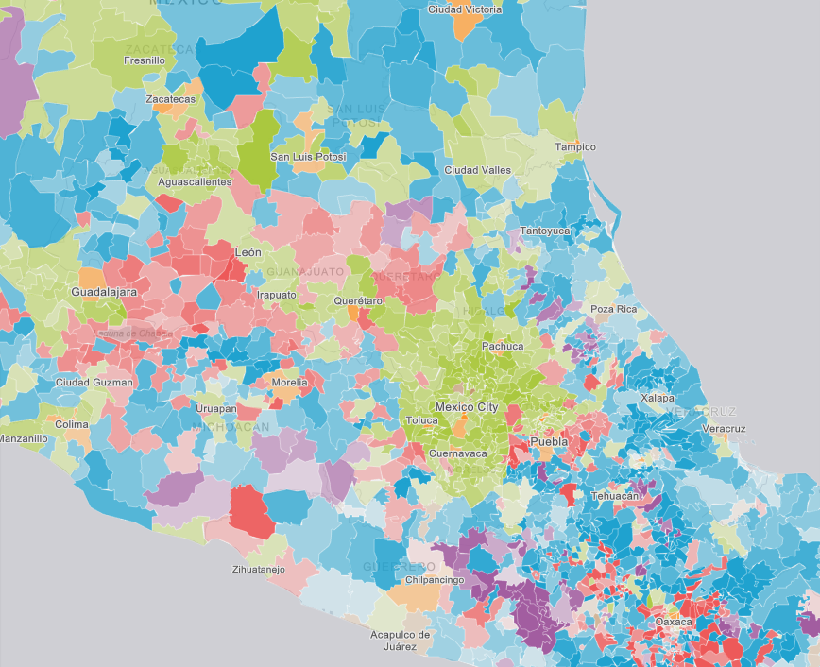
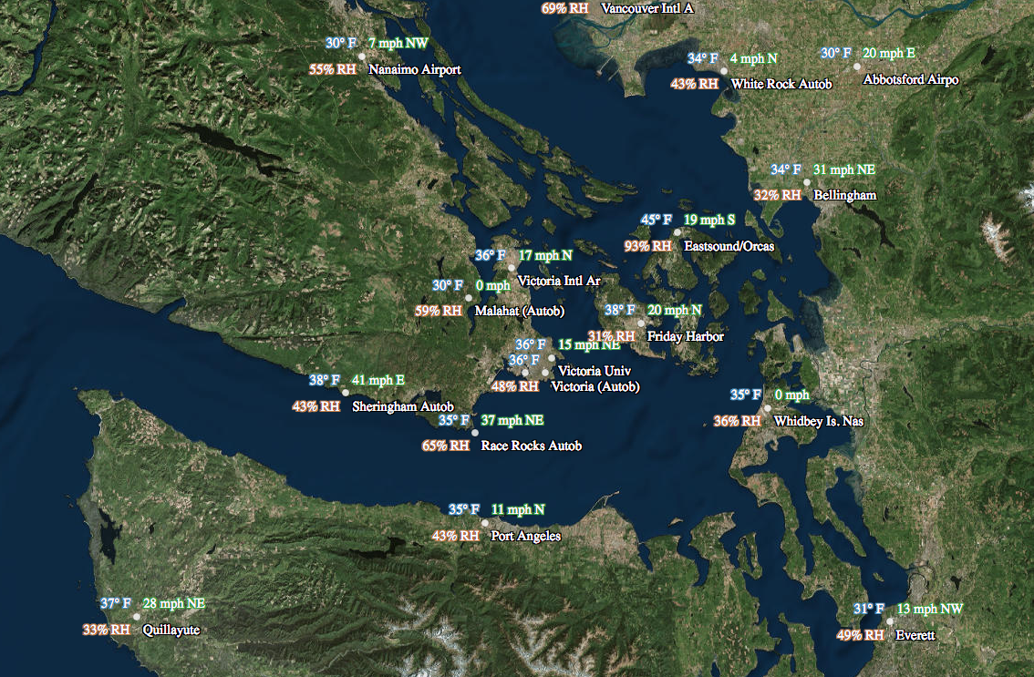
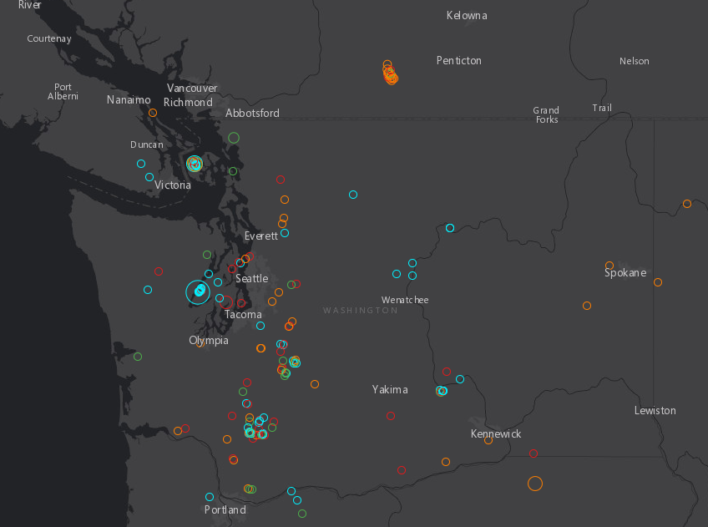
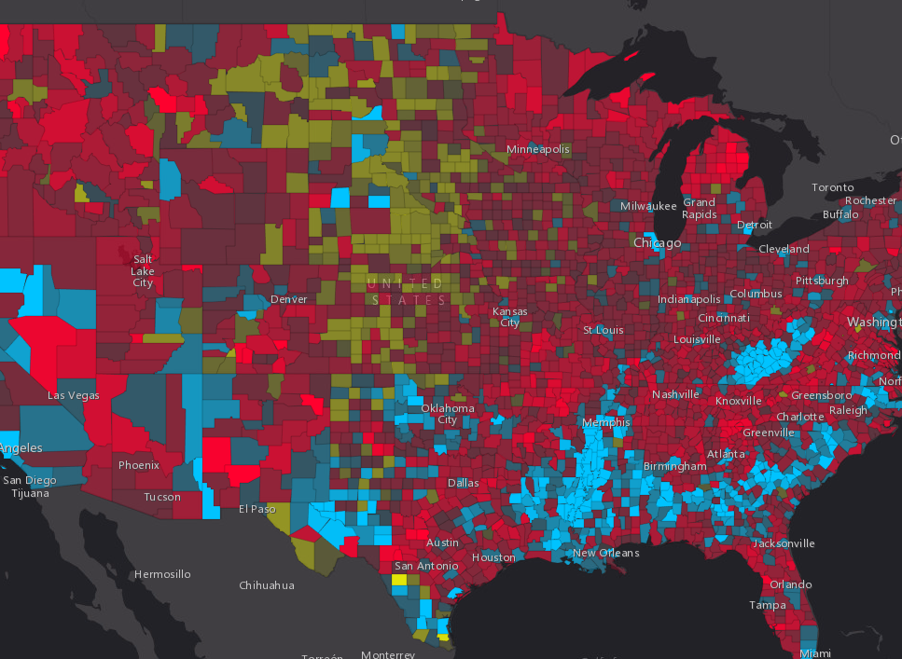
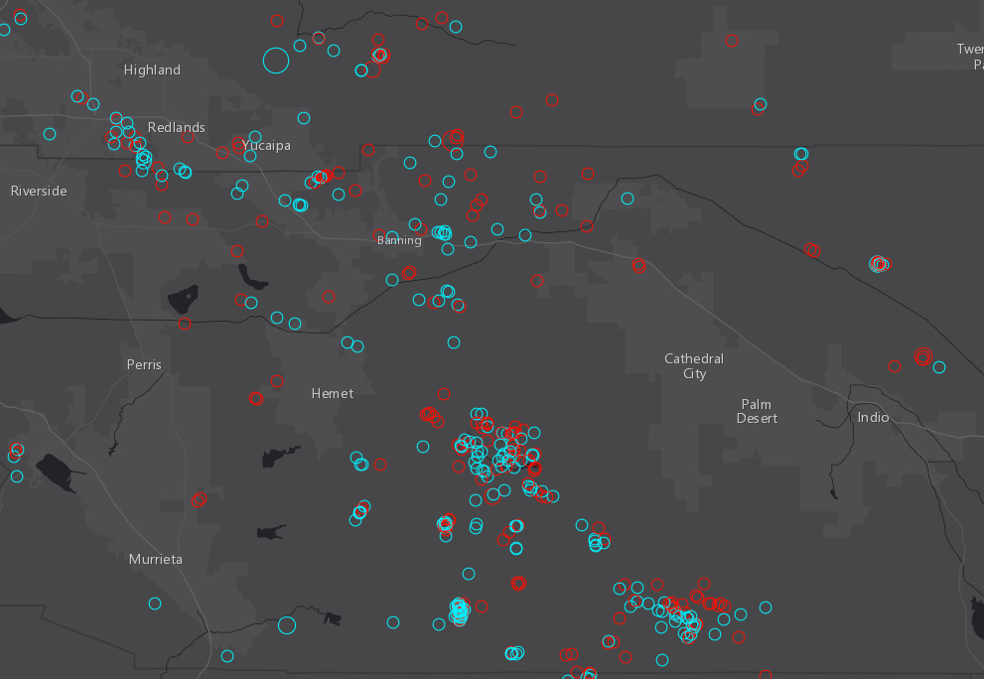
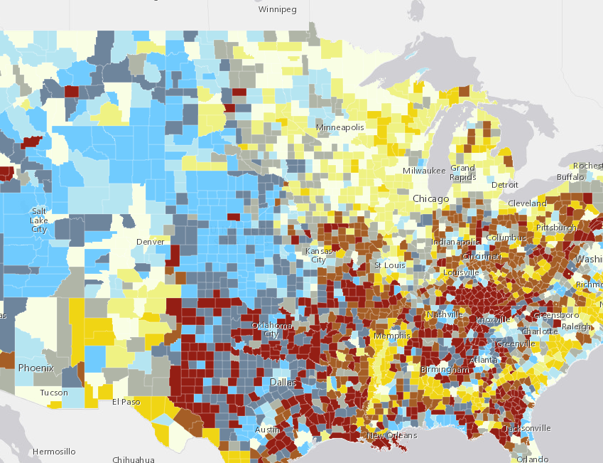
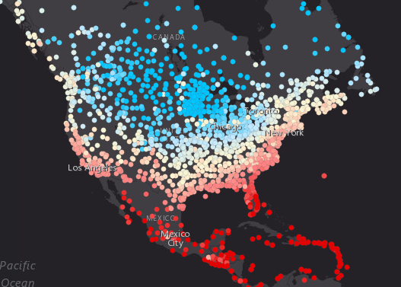
Demos
Programming in ESRI JS API with Arcade
Notes:
Now you have seen the language….
Implicit Return one
Lets look at more Complex Examples

Slide 36
Arcade Interpreter : Inside of JS App using Arcade
Script Parsed into Syntax Tree
Compiled Arcade Script Executed
API Expression Property Set
Result Returned for On Demand Execution
Profile Context Constructed
On Demand Execution of Expression
Script Compiled
Standard Execution Lifecycle of Arcade Script
Script Parsed into Syntax Tree
Arcade Interpreter - Statement by Statement Execution
API Expression Property Set
Result Returned for On Demand Execution
Profile Context Constructed
On Demand Execution of Expression
Browser Restricted Execution of Arcade Script
Notes:
[DAVE]
As a last note, I thought we could explain how Arcade is Executed…
There are actualy two execution pipelines in the JS API, an optimised one, and interpreted one.
The reason why have two, is so that if the Browser has really been locked down in its behaviour, arcade expressions wil still work. The optimised pipelines is approximately 3x faster than the un-optimised pipeline.
The way the script is understood is as follows.
1. Expression is Parsed, and turned into a Machine Representation of the Script. A syntax tree
2. This machine representation is compiled into native JavaScript. This compilation process is a statement by statement re-expression of the script. It is not rewriting as JavaScript, but a language level articulation. This is because it must honour the Arcade type system, function behaviour everything.. The way of thinking about this, is to consider how C code is turned into assembly.
3. When the script is executed, the compiled function is called, with different input variables.
The browser restricted version, uses an Arcade Interpreter, where the statements are stepped through one by one, and does not compile the script to JavaScript.
With both pipelines, the driving factor has been security and speed. Arcade Expressions can only do what the language has allowed the user to express.

Slide 37
Future
Notes:
[KRISTIAN]
So what is the future of Arcade
More Arcade
More Functions

Slide 38
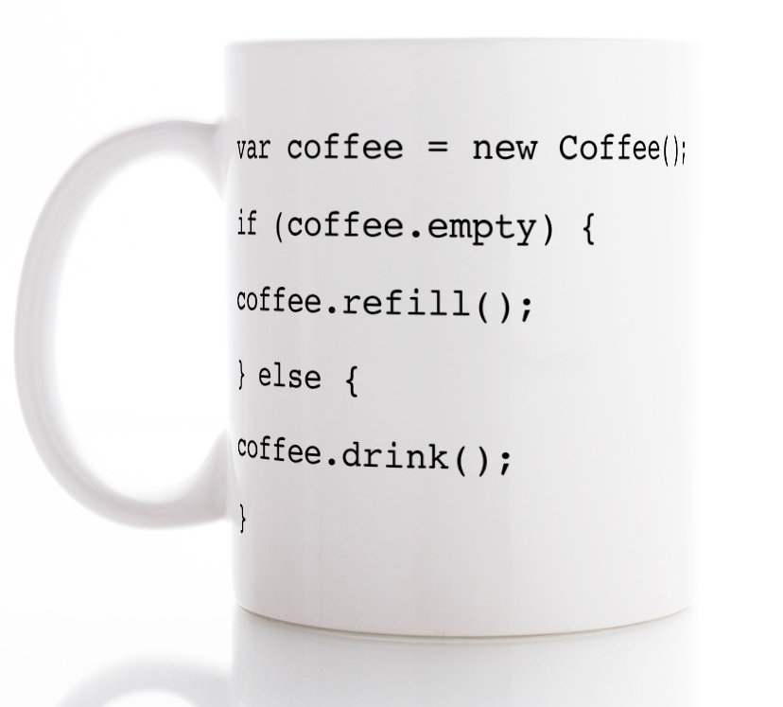
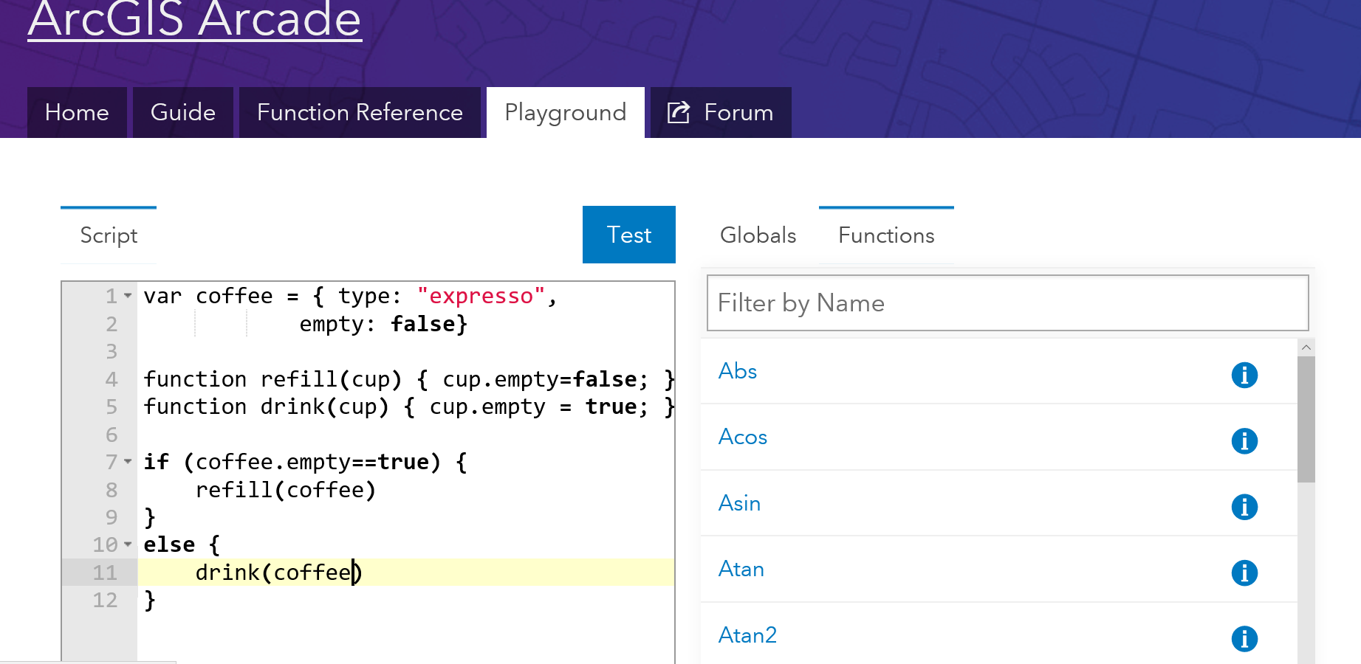
More uses of Arcade
Field Calculators
Pop-ups
Notes:
Firstly we want to use Arcade in more places within the ArcGIS Platform

Slide 39
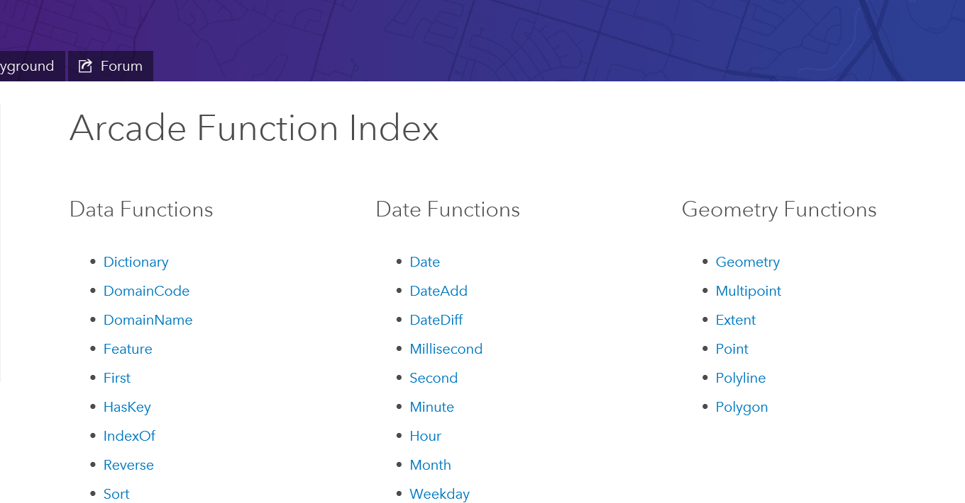
Adding Functions
Identifying Common Operations
Let us know what you need!
Notes:
We want to added more functions, to make Arcade more powerful

Slide 40
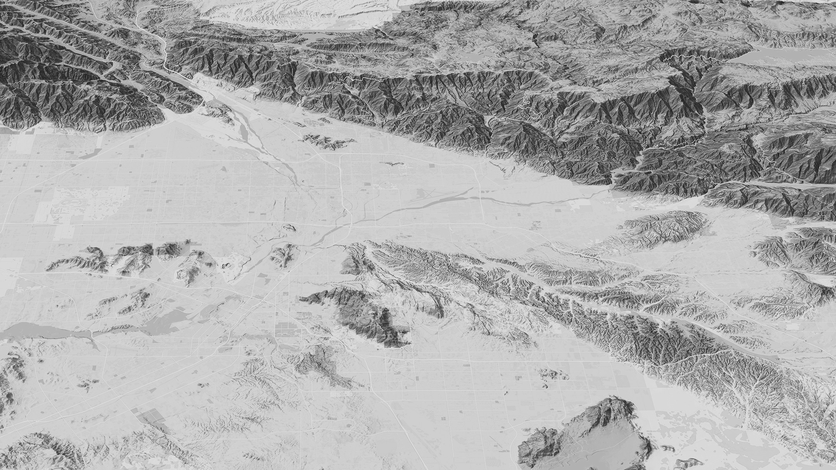

Finding Arcade Resources
Notes:
A big headache with any language or script expression.. Whether it is an Excel Formula, ActionScript, JavaScript or C# is where to find resources.
We have spent a bit of time putting together the help for Arcade online

Slide 41
Resources
For Arcade Documentation
https://developers.arcgis.com/arcade
Playground https://developers.arcgis.com/arcade/playground/
Using Arcade with JS API
https://developers.arcgis.com/javascript/latest/guide/arcade/index.html
Blogs and Posts https://blogs.esri.com/esri/arcgis/2016/12/19/introducing-arcade/
https://blogs.esri.com/esri/arcgis/2016/12/15/use-arcade-expressions-to-map-your-ideas/
http://odoe.net/blog/hello-arcade/
https://blogs.esri.com/esri/arcgis/2017/01/10/using-arcade-expressions-in-web-apps/

Slide 42
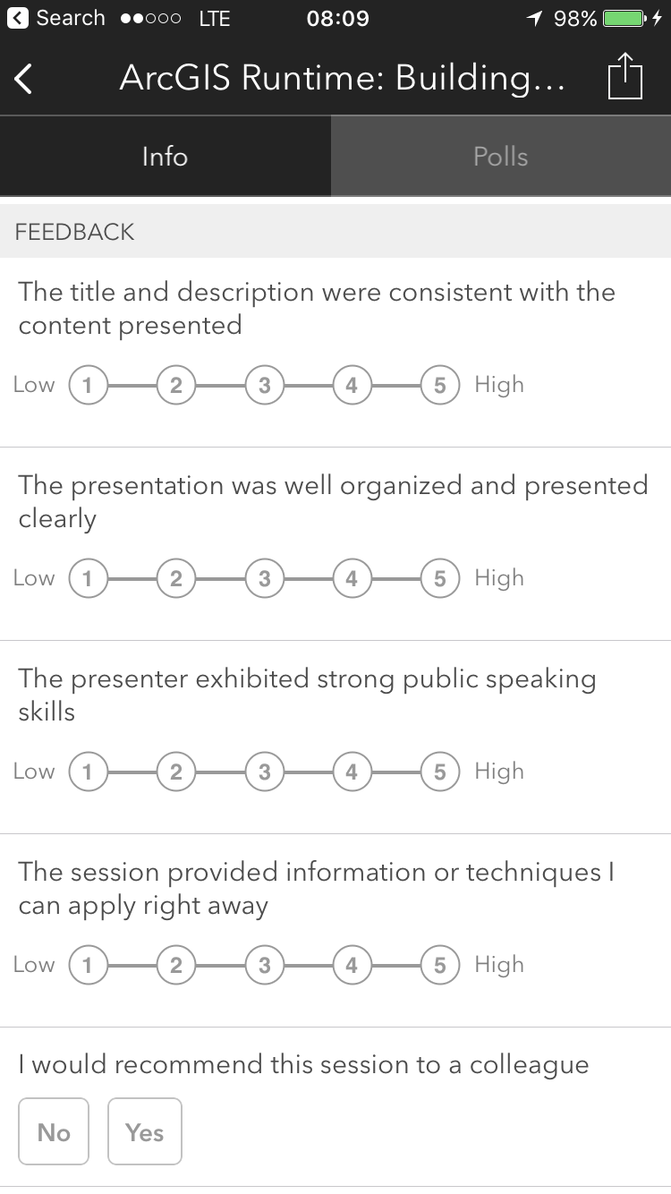
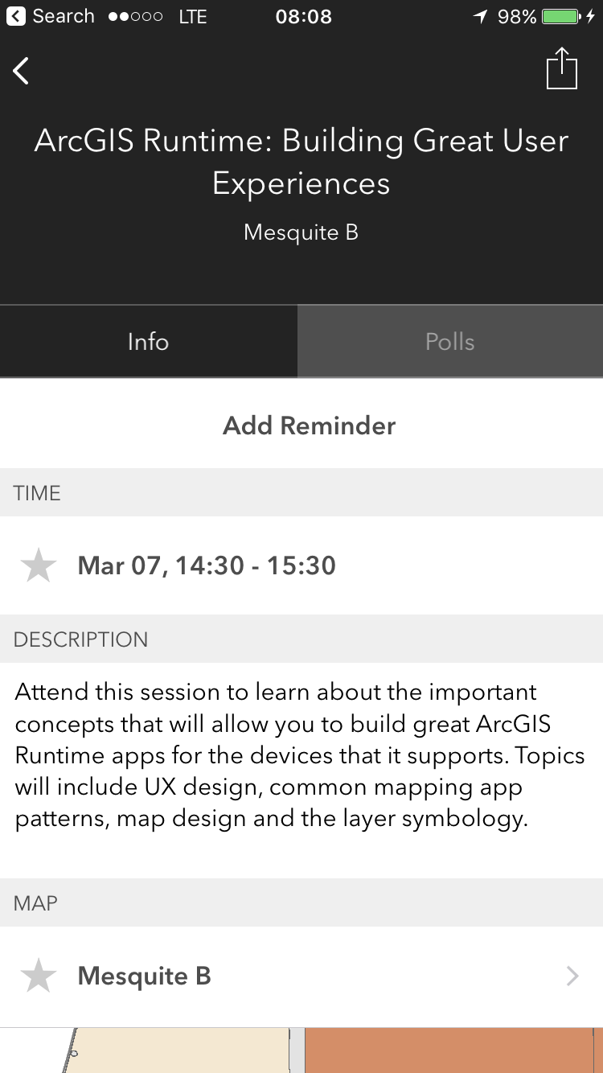
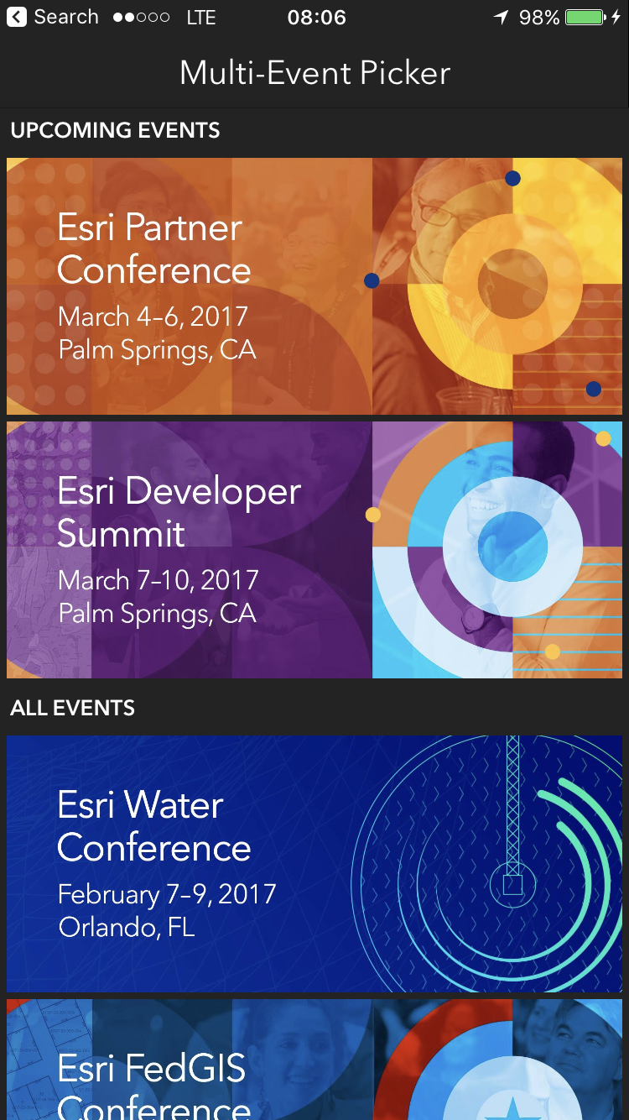
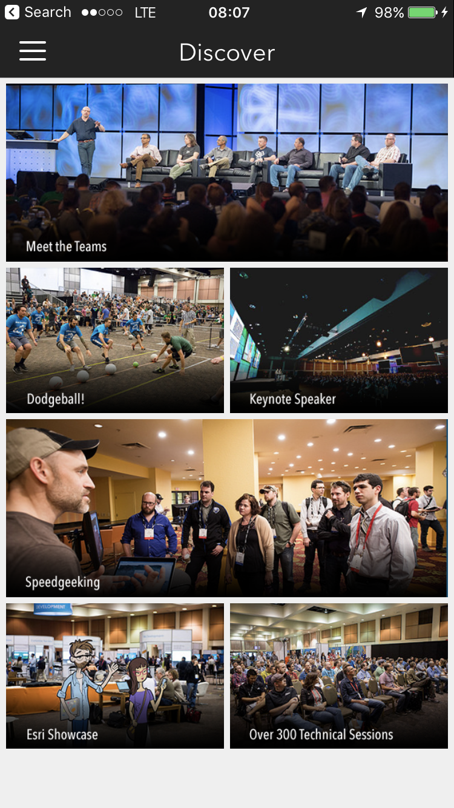
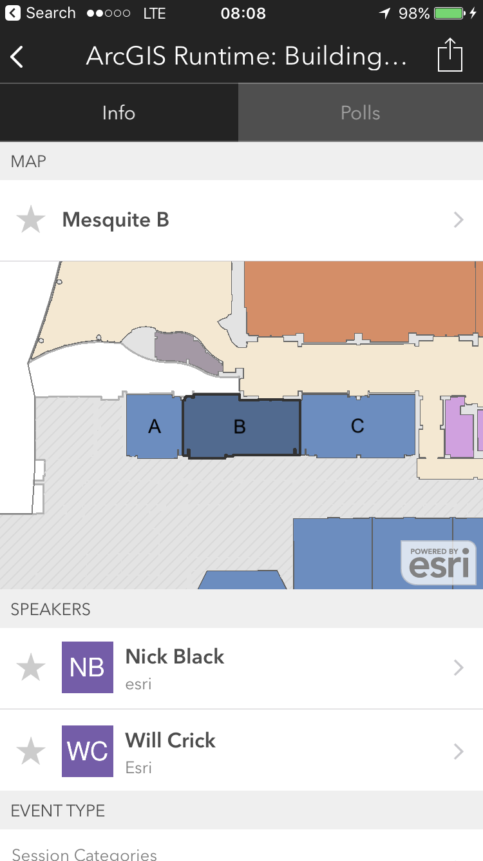
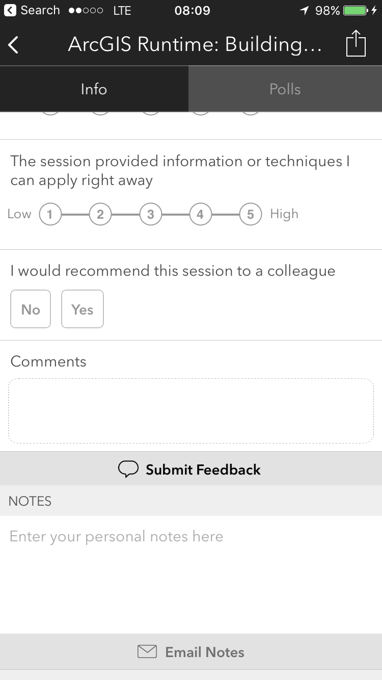
Please Take Our Survey!
Scroll down to the
“Feedback” section
Download the Esri Events app
and go to DevSummit
Select the session you attended
Complete Answers,
add a Comment,
and Select “Submit”

